Slide 1



MESSIAH
@messiahapp
www.messiahapp.com
/messiahapp

Slide 2

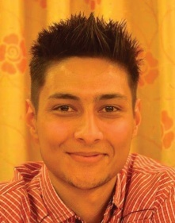
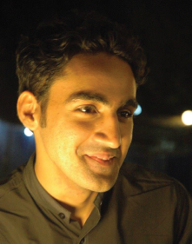
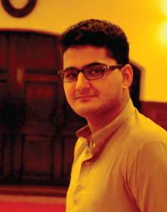
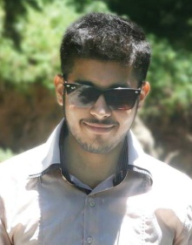
THE TEAM
EBTIHAJ
Founder and
Graphic Designer
Masters in Computer Sc
ZAHID ALI
Co-Founder and
Android developer
Masters in Computer Sc
MUBASSIR HAYAT
Co-Founder and
Web developer
Bachelors in Computer Sc
HAROON BAIG
Co-Founder and
iOS Developer
Bachelors in Computer Eng
@messiahapp
www.messiahapp.com
/messiahapp

Slide 3
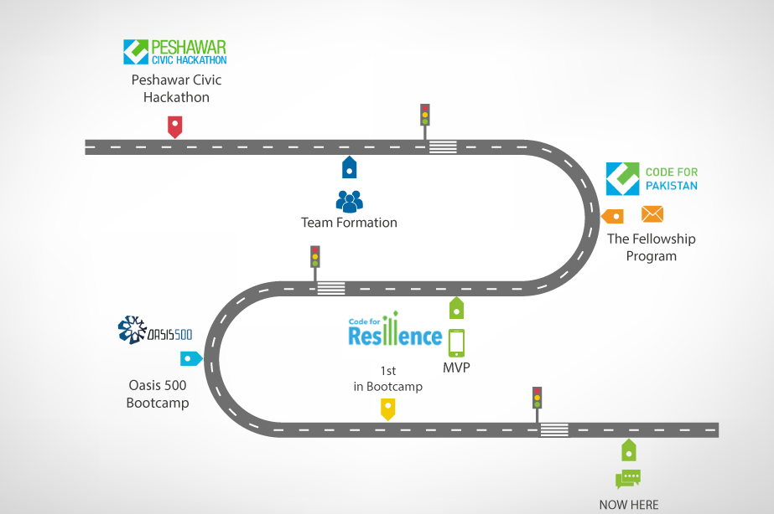
BACKGROUND
@messiahapp
www.messiahapp.com
/messiahapp

Slide 4
OVERVIEW
Messiah is an emergency first responder that implements the neighborhood watch concept and asks your neighbors or someone nearby to help you out in an emergency within a minute or two instead of waiting for the relief departments to arrive at the scene 5 to 10 minutes late, in a case where every second counts.
@messiahapp
www.messiahapp.com
/messiahapp

Slide 5
THE PAIN
For every 100 people who call 911 (one of the quickest emergency response organization) for help, 66 of them had to wait for more than 5 minutes and the remaining 34 had to wait for more than 10 minutes to get the response, in a case where every second counts.
Imagine having a robber at home or anyone having a medical condition, would that help?
@messiahapp
www.messiahapp.com
/messiahapp

Slide 6
SOLUTION
The app allows you to notify the people around you that you need immediate help with a link pinpointing your current location, who indeed can arrive at the scene much faster than the local rescue agencies.
@messiahapp
www.messiahapp.com
/messiahapp

Slide 7
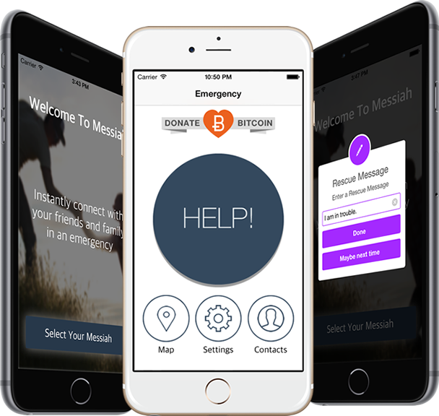
SCREEN SHOTS
@messiahapp
www.messiahapp.com
/messiahapp

Slide 8
ONE MORE THING
Accident Detection.
@messiahapp
www.messiahapp.com
/messiahapp

Slide 9
The Opportunity
Anyone can run into a problem anytime, anywhere.
240 million calls are made yearly to 911 asking for help.
@messiahapp
www.messiahapp.com
/messiahapp

Slide 10
BUSINESS MODEL
Freemium model.
Subscription based,
50c/user/month
Donations in 6 different V.Cs.
Tracking through web app
2 $/subscription/month
@messiahapp
www.messiahapp.com
/messiahapp

Slide 11
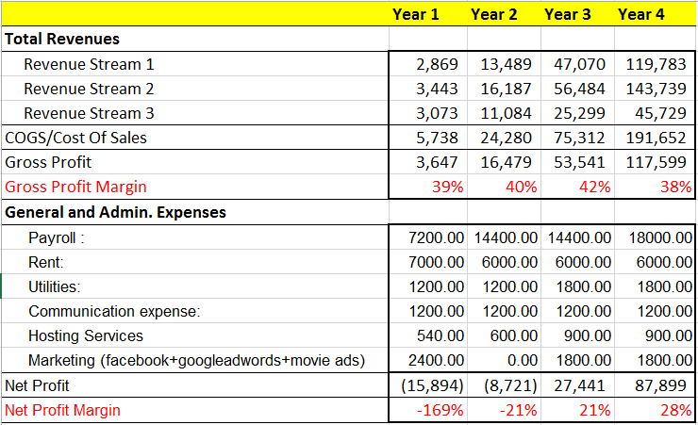
FINANCIALS: PROJECTIONS FOR 4 YEARS
@messiahapp
www.messiahapp.com
/messiahapp

Slide 12
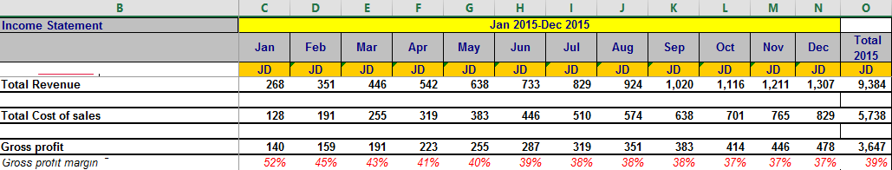
FINANCIALS: 1ST YEAR BROKEN DOWN TO MONTHS TILL GROSS PROFIT MARGIN

Slide 13
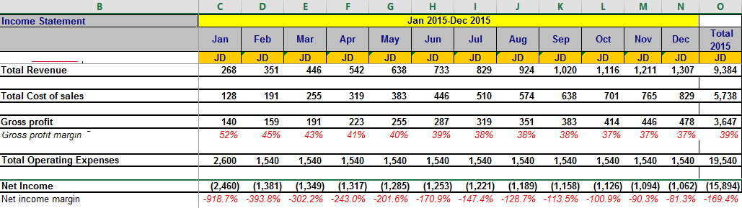
FINANCIALS: 1ST YEAR BROKEN DOWN TO MONTHS TILL NET PROFIT MARGIN

Slide 14
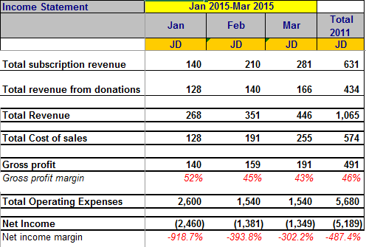
FUNDING REQUIRED FOR THE FIRST 3 MONTHS
MILESTONES:
MONTH1: Reach 4250 users and atleast 128 paying users.
MONTH2: Reach 8500 users and atleast 191 paying users.
MONTH3: Reach 12750 users and atleast 255 paying users.
@messiahapp
www.messiahapp.com
/messiahapp

Slide 15
FUNDING REQUIRED FOR THE FIRST YEAR
IN FIRST YEAR WE NEED 30,000 JD for:
51000 users.
829 paying users.
Establish office.
Hiring experts.
Marketing.
@messiahapp
www.messiahapp.com
/messiahapp

Slide 16
SUMMARY
As per Quran “whoever kills a human begin, it shall be as if he killed all mankind, and whoever saved the life of one, it shall be as if he had saved the life of all mankind”.
So our is aim not only to establish our startup but to save some lives and earn some recognition for the life hereafter.
@messiahapp
www.messiahapp.com
/messiahapp

